Slide 1
CS-205 Data Structure and Algorithms
8. Queues
Weihao Qu
Monmouth University

Slide 2
Review of stacks
Last-in-first-out (LIFO)
Main operations:
  push(e): add element e, to be the top of the stack
  pop: remove from the stack and return the top element on the stack
Other methods:
  size(): return the number of elements in the stack
  isEmpty(): return a boolean indicating if the stack is empty
  top(): Return the top element in the stack, without removing it.

Slide 3
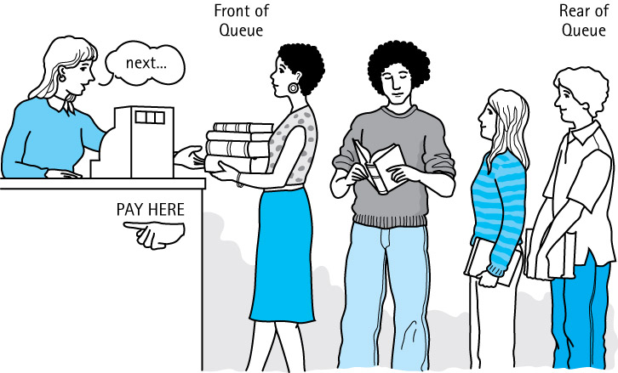
Queues
Queue A structure in which elements are added to the rear and removed from the front; a “first in, first out” (FIFO) structure

Slide 4
Queues
First-in-first-out (FIFO)
Main operations:
  enqueue(e): insert element e at the rear of the queue
  dequeue: remove and return from the queue the element at the front
Other methods:
  size(): return the number of elements in the queue
  isEmpty(): return a Boolean indicating if the queue is empty
  front(): Return the front element in the queue, without removing it.

Slide 5
Operations on Queues
Constructor
  new - creates an empty queue
Transformers
  enqueue - adds an element to the rear of a queue
  dequeue - removes and returns the front element of the queue

Slide 6
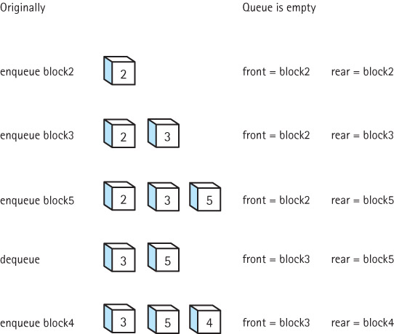
Effects of
Queue
Operations

Slide 7
Array-based Queue
Use an array of size N in a circular fashion
Two variables keep track of the front and size
  f index of the front element
  sz number of stored elements
When the queue has fewer than N elements, array location r = (f + sz) mod N is the first empty slot past the rear of the queue
normal configuration
Q
0
1
2
f
r
wrapped-around configuration
Q
0
1
2
r
f

Slide 8
Queue Operations
We use the modulo operator (remainder of division)
Algorithm size()
return sz
Algorithm isEmpty()
return (sz == 0)
Q
0
1
2
f
r
Q
0
1
2
r
f

Slide 9
Queue Operations (cont.)
Operation enqueue throws an exception if the array is full
This exception is implementation-dependent
Algorithm enqueue(o)
if size() = N − 1 then
throw IllegalStateException
else
r ← (f + sz) mod N
Q[r] ← o
sz ← (sz + 1)
Q
0
1
2
f
r
Q
0
1
2
r
f

Slide 10
Queue Operations (cont.)
Note that operation dequeue returns null if the queue is empty
Algorithm dequeue()
if isEmpty() then
return null
else
o ← Q[f]
f ← (f + 1) mod N
sz ← (sz − 1)
return o
Q
0
1
2
f
r
Q
0
1
2
r
f

Slide 11
Queue interface in Java
public interface Queue<E> {
public int size();
public boolean isEmpty();
public E front() throws EmptyQueueException;
public void enqueue (E element);
public E dequeue() throws EmptyQueueException;
}

Slide 12
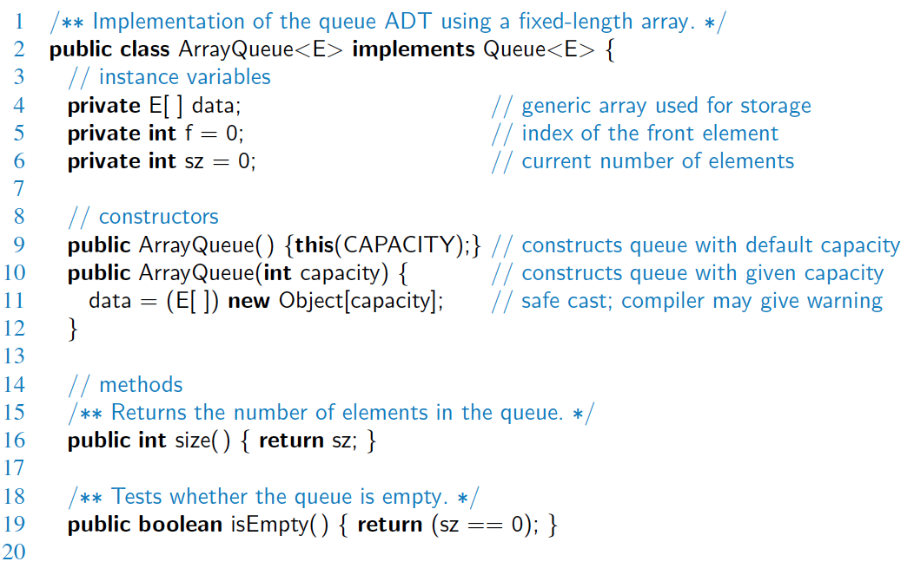
Array-based Implementation

Slide 13
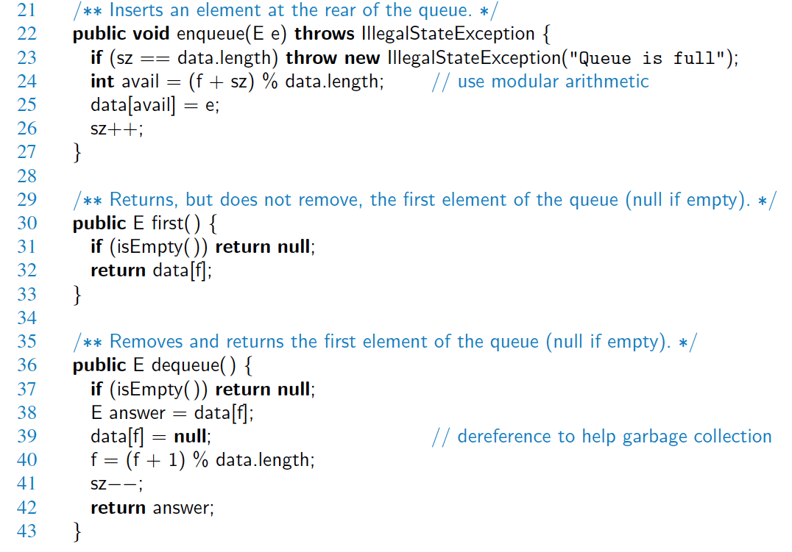
Array-based Implementation (2)

Slide 14
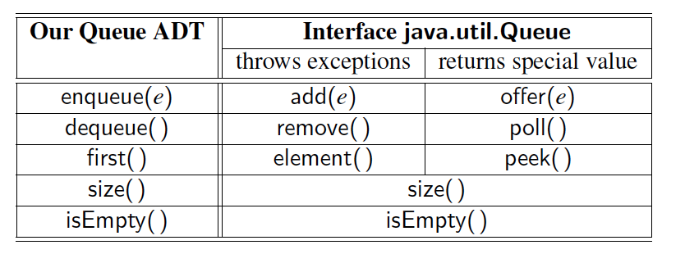
Comparison to java.util.Queue
Our Queue methods and corresponding methods of java.util.Queue:

Slide 15
Linked list based queue
Implemented based on singly linked list
Node definition?
public void enqueue(E elem) {
Node<E> node = new Node<E>();
node.setElement(elem);
node.setNext(null); // node will be new tail node
if (size == 0) // special case: empty queue
head = node;
else
tail.setNext(node); // add node at the tail of the list
tail = node; // update the reference to the tail node
size++;
}

Slide 16
Linked list based queue
public E dequeue() throws EmptyQueueException {
if (size == 0)
throw new EmptyQueueException("Queue is empty.");
E temp = head.getElement();
head = head.getNext();
size--;
if (size == 0)
tail = null; // the queue is now empty
return temp;
}
Implement
  public E front() throws EmptyQueueException{…}

Slide 17
Double-ended queues
public interface Deque<E> {
public int size(); // Returns the number of elements in the deque.
public boolean isEmpty(); //Returns whether the deque is empty.
public E getFirst() throws EmptyDequeException;
public E getLast() throws EmptyDequeException;
public void addFirst (E element); //Inserts an element to be the first.
public void addLast (E element); //Removes the first element
public E removeFirst() throws EmptyDequeException;
public E removeLast() throws EmptyDequeException;
}

Slide 18
Linked list deque
Implemented based on doubly linked list
Node definition?
public class NodeDeque<E> implements Deque<E> {
protected DLNode<E> header, trailer;
protected int size;
public NodeDeque() {
header = new DLNode<E>();
trailer = new DLNode<E>();
header.setNext(trailer);
trailer.setPrev(header);
size = 0;
}

Slide 19
Linked list deque
public int size() {
return size;
}
public boolean isEmpty() {
if (size == 0) return true;
return false;
}
public E getFirst() throws EmptyDequeException {
if (isEmpty()) throw
new EmptyDequeException("Deque is empty.");
return header.getNext().getElement();
}

Slide 20
Linked list deque
public void addFirst(E o) {
DLNode<E> second = header.getNext();
DLNode<E> first = new DLNode<E>(o, header, second);
second.setPrev(first);
header.setNext(first);
size++;
}
public E removeLast() throws EmptyDequeException {
if (isEmpty()) throw new EmptyDequeException("Deque is empty.");
DLNode<E> last = trailer.getPrev(); E o = last.getElement();
DLNode<E> secondtolast = last.getPrev(); trailer.setPrev(secondtolast);
secondtolast.setNext(trailer);
size--;
return o;
}
}

Slide 21
Exercises
Page 252: R-6.7

Slide 22

Exercises
Page 254: C-6.24

